Slide 1





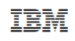









Operational Threat & Risk Information Sharing and Analytics
TEAM Threat

Slide 2
Draft specification artifacts
Specification Documents: https://github.com/ModelDriven/ThreatRisk/tree/master/Draft%20Submission%202016-12
Web view of models: http://tinyurl.com/q29clvk
http://www.threatrisk.org/spec/Threat%20Risk%20Model.html
Community portal: http://threatrisk.org/
Download Now

Slide 3
Problem Space
There is a critical need to understand and mitigate threats and risks – to “connect the dots”.
The Landscape of threats is changing
Multiple attack vectors, cyber/physical and other
Advanced threats utilize multiple vulnerabilities
There are multiple communities addressing the same threats
Cyber/physical, emergency management, safety, defense, etc.
No comprehensive consistent semantic framework
Existing systems provide insular treatment of threat/risk relationships
Comprehensive system would allow system-of-systems interoperability (private/private, public/private)

Slide 4
What we need is an integrating framework that supports automated data mapping
Cyber
Crime
Terrorism
Critical Infrastructure
Natural
Disasters
Integrating Framework for Threats and Risks
Sharing & Analytics
Sharing & Analytics
Sharing & Analytics
Sharing & Analytics
Sharing & Analytics
An integrating framework that helps us deal with all aspects of a risk or incident
A federation of risk and threat information sharing and analytics capabilities

Slide 5
Primary classes of use cases
Transformation from one information sharing data format to another
Example: STIX Cyber Event to NIEM to a CAP Alert
Analytics of information federated from multiple sources
Examples:
Fusion center “connects the dots” between a stolen laptop (from NIEM) and a cyber incident (From STIX)
Bio hazard detected by automated instruments and collaborated by local health care professionals

Slide 6


Shift in information sharing approach
Schema Based
Concept Based
Ask every stakeholder and system to adapt to externally imposed fixed schema, change in schema or systems requires development
Ask every stakeholder to map their schema to shared concepts, data mappings are automated & agile

Slide 7
Approach
Highlight O(N) vs. O(N^2)
Cyber
Terrorism
Construct a conceptual model informed by existing schema, research and best practices
This conceptual model is independent of specific data structures, technologies and terminologies
Define mapping models between the conceptual model and purpose/technology schema
Make both models sufficiently precise that they can drive automated bridging between any mapped schema
Cyber
Cyber
Cyber
Disasters
Map/Bridge
Map/Bridge
Map/Bridge
Conceptual Model
Map/Bridge
Map/Bridge
Criminal
Cyber
Criminal
Infrastructure

Slide 8

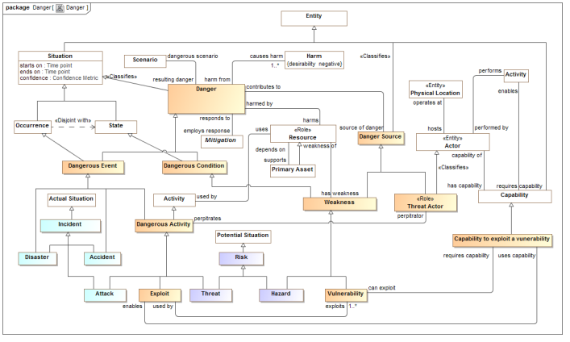
Conceptual Model Inputs
KDM
(Risk)
NIST Framework
Conceptual Model
NIEM
(General)
STIX
(Cyber)
OGC
(Geo)
EDXL
(Emergency)
FIBO (Finance)
SEI
(Safety)
CAL OES
(Health)
ISO
(Risk)
ISO
(Units)
RMS
(Custody)
There is still more to do to fully integrate the above and we anticipate more inputs and use cases

Slide 9
Models to Capabilities
Mappings
Conceptual Model
Vocabularies
Ontologies
Data Schema
STIX, NIEM, EDXL, Others
Data Transformations
Products and services implementing the standard provide the capacities for information sharing, federation and analytics based on mappings to data-focused technologies

Slide 10
The Process
Building a community and standards to protect against threats and risks

Slide 11
Open Community Process
Our goal is to create and encourage
Open standards for threat and risk information sharing
A community of information providers, consumers, analysts and products
The standards process is organized under the “Object Management Group” (www.omg.org)
The community “home” is www.threatrisk.org
While not required by OMG process, the submission team publishes draft specifications to invite comment, engagement, community building and implementation. OMG Membership is encouraged but not required.
Stakeholders may contribute to the specification.
We are also exploring options for open source implementations

Slide 12

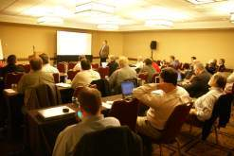
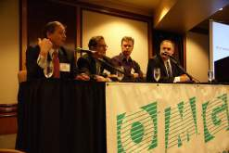
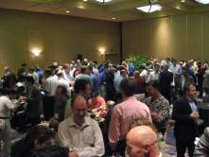
Who Is OMG?
Object Management Group (OMG):
Founded in 1989
More than 470 member companies
The largest and longest standing not-for-profit, open-membership consortium which develops and maintains computer industry specifications.
Continuously evolving to remain current while retaining a position of thought leadership.
Notes:
Which are membership requests, submits, develops and maintains To help achieve the objectives of Reusability, interoperability and portability
These standards are requested, submitted, adopted and maintained by the membership.

Slide 13




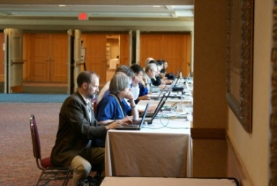
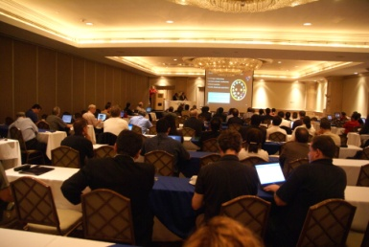
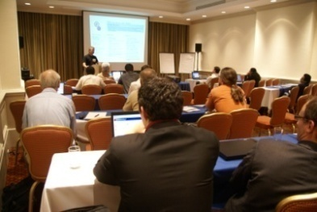
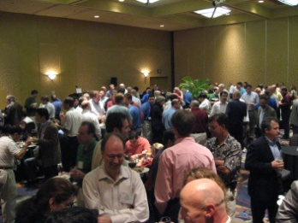
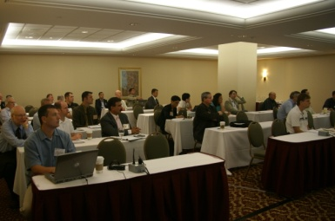
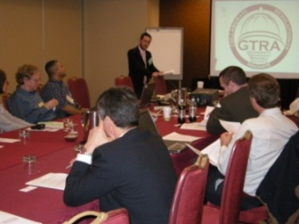
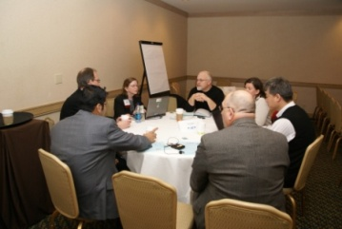
Developing Standards
Standards are developed using OMG’s mature, worldwide, open development process. With over 20 years of standards work, OMG’s one-organization, one-vote policy ensures that every vendor and end-user, large and small, has an effective voice in the process.
Notes:
13

Slide 14






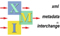
OMG’s Best-Known Successes
Common Object Request Broker Architecture
CORBA® remains the only language- and platform-neutral interoperability standard
Unified Modeling Language
UML® remains the world’s only standardized modeling language
Business Process Modeling Notation
BPMNTM provides businesses with the capability of understanding their internal business procedures
Common Warehouse Metamodel
CWMTM, the integration of the last two data warehousing initiatives
Meta-Object Facility
MOFTM, the repository standard
XML Metadata Interchange
XMI®, the XML-UML standard

Slide 15
Submitters and Contributors (Thus Far)
Information Sharing Environment (ise.gov)
Demandware
U.S. Air force
U.S. Defense Security Services
California Public Safety (http://www.Caloes.ca.gov)
U.S. National Information Sharing Model PMO (https://www.niem.gov/)
Duke Energy
NSA/UCDMO
NIST
INCOSE
Integrated Networking Technologies, Inc.
Tibco Software Inc.
Hitachi
NC4
Others pending approval
Model Driven Solutions division of Data Access Technologies
KDM Analytics, Inc.
International Business Machines, Inc.
RSA, The Security Division of EMC
Lockheed Martin, Inc.
Oracle Corporation
Fujitsu
Team Threat

Slide 16
Summary Of OMG RFP Process
Task force identifies need
Task force proposes RFP to be issued, goes through OMG process
Submission team(s) form to produce proposed specification(s)
Two or more revision cycles propose specifications
Through rigorous process, OMG adopts “Beta” specification
You
Are
Here
Finalization task force forms, works to resolve any implementation issues
Issues are addressed, final adopted specification proposed.
Adoption of final speciation through OMG process.

Slide 17
Status
Threat Modeling project kicked off in Dec 2013
Initial submission was made May 2015
Next (and probably final) revised submission May 5th
Full adoption by OMG Board of Directors: Mid to late 2017
Implementation efforts need not wait, draft specification can (and should) be implemented to validate the proposed standard.

Slide 18
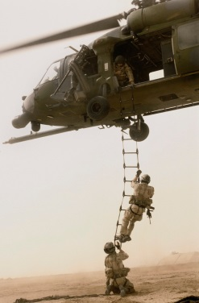
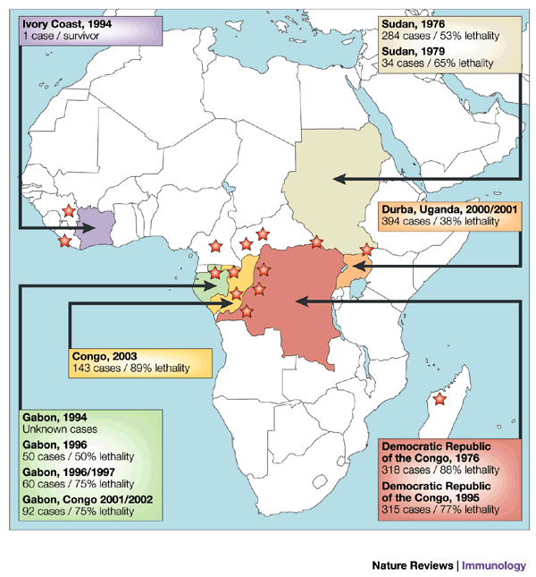

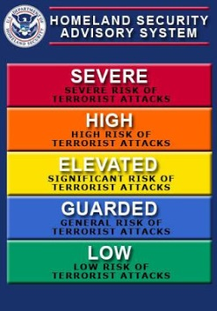



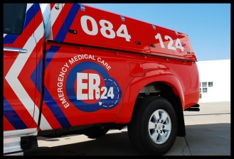


Stakeholder roles in our community
Risk/Threat
Information Sources
Data Fusion
& Brokers
Analysts
Defenders
Responders
Vendors & Service Providers
One organization may play multiple roles

Slide 19
Use Case – Critical Infrastructure
Target: A group of organizations that collaboratively manage critical infrastructure and utilize Industrial Control Systems.
Power, water and other critical infrastructure are threatened by cyber and physical terrorism.
Industrial Control Systems are increasingly computer controlled and connected (directly or indirectly) to the internet and may embed compromised control hardware/software from questionable sources.

Slide 20




Potential Information Flows
Suspicious Activity Report
NIEM
Incident
Arrest Report
STIX Incident
Tactical Response Unit
Fusion Center
Intelligence
Report
IT System Hardening
Manual Shutdown
Public CAP Warning

Slide 21

Example - Snowmageddon
In January 2015 Massachusetts faced the Hazard of major winter storms across the region. Potential Harm from blizzards and winter storms includes negative economic impact, limited road accessibility, restricted emergency management, non-availability of utility, property damage, personal injury and death, and more.
The onset of a winter storm or blizzard was predicted by the National Weather Service (NWS).

Slide 22
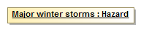
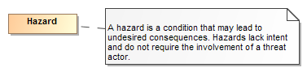
Example of structuring risk information
In January 2015 Massachusetts faced the Hazard of major winter storms across the region.
Is formalized as
Is defined by
A data syntax and vocabulary
Maps To
<drn:PotentialDanger>Major winter storms</drn:PotentialDanger>

Slide 23
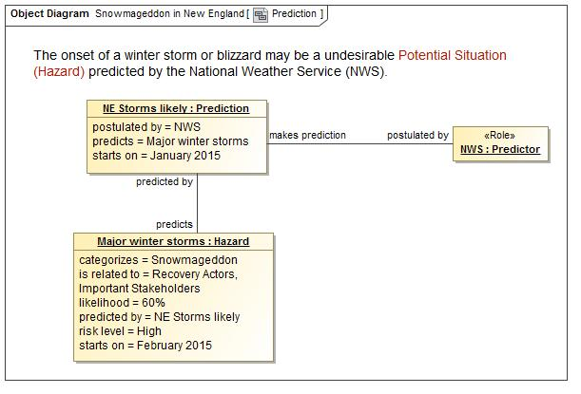
A Potential Storm? Who said this?

Slide 24
Precepts
The purpose/organizational/technology specific schema will not (should not) go away
A “one size fits all” solution will not work
There will be no one technology
There will be no one terminology or language
There will be no one data structure for threats and risks
Our focus is federation
Understanding the concepts behind the schema
Mapping them to/through a common conceptual model
Enabling interoperability by bridging between the specific schema
Supporting integration and coordination of mitigation and response capabilities

Slide 25
Core Concept: Comprehending Planned and Unplanned Threats
“All hazards” include man-made and natural disasters/system failures
There is not always an actor involved (e.g. hurricane, system malfunction)
Intentional threat actors are not the only source of threats
Non-malicious actors may constitute significant threat (e.g. spear-phishing victim, power plant operator)
Defenders (e.g. system admins, law enforcement, medical staff) are also actors with defensive plans
Victims are actors as well

Slide 26

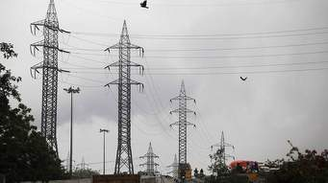
Core Concept: Attacker/Defender Symmetry
Attack perspective:
Defender: Attackers/hazards are threats
Attacker: Targets are opportunities
Defense perspective:
Attacker: Successful defense is a threat to the intentions/objectives
Defender: Maintaining effective defensive posture is an opportunity
Threat vs. Opportunity is in the eye of the emoticon – it is not sufficient to create static classifications
Opportunity!
Capability to disrupt the power grid
Threat!
Notes:
One mans risk is another mans opportunity
The same risk/threat/incident needs to be understood from very different perspectives
Classifying something as a risk/threat/incident or mitigation only makes sense with respect to how it impacts the objectives of some stakeholder. E.g “a risk of damage to the U.S. power grid impacting millions”.
The conceptual model supports this separation while mapping to structures that assume a particular perspective.

Slide 27
Understanding the models

Slide 28
Kinds of models
Conceptual models
Defines the terms and concepts of the threat & risk domain as a semantic model. Conceptual models can also be transformed to ontologies.
Data models
Represents specific logical or physical data schema for a specific purpose – more concrete and structured.
Data models are a direct representation of some kind of schema, e.g. XML Schema, SQL Schema or RDF Schema.
Mappings
Mappings relate a data model to one or more conceptual models to provide for automated transformation and federation of information in these deferent formats.
The conceptual models become the “pivot point” between multiple data representations of the same and related concepts.

Slide 29
Pivoting Through a Conceptual Model
“Source”
Data
Representation
Data representations (Schema & Instances)
Model data for a purpose using a technology
“Instances” are data structures (e.g. SQL tables or XML documents) – “facts” about the things in the world from some perspective
Conceptual Domain Models (CDM)
A conception of the world by a group of stakeholders – less purpose specific
“Instances” are things in the world – so can’t be in models
Using abstraction, we can have multiple representations of facts about the world in different data structures and technologies
Rules define how domain concepts can be represented in a particular form – rules can be simple and generic or heavyweight and specific, depending on the representation.
“Target”
Data
Representation
Represent
Rules
Conceptual Domain Models
(Models of the world)

Slide 30
Mappings included
STIX – Structured Threat Information Exchange, for Cyber threat information. (Moving to Oasis “CTI”)
NIEM – National Information Exchange Model – For justice, public safety and other domains.
NIST 800-53 – Security and Privacy Controls for information systems. This is not a data mapping but shows how the concepts support the controls.
Note: More mappings are anticipated as the initiative unfolds. Some may be published but not standardized.

Slide 31
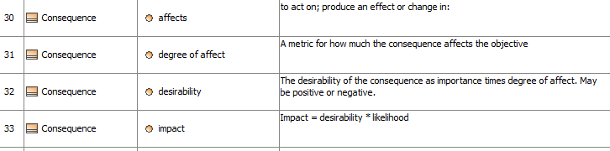
Representing the data and schema
Options
UML Diagrams
Tables
Schema
UML is about the information and semantics, not the diagrams. The diagrams and tables support communication of the concepts.

Slide 32
Conceptual Model Layering
Operational threat situational awareness and response
Operational risk evaluation and mediation
Cross-risk/threat – specific “wide and shallow” risk and threat concepts/ E.G. Risk, threat, danger, consequence
Generic Library – Provides concepts and links across multiple viewpoints, not just threat/risk. E.G. Person, Objective
Kernel– Foundational concepts for modeling anything: Entities, Roles, Relations, Types, Information, Rules, Identity, Etc…
Imports the model from SMIF

Slide 33
Conceptual Model Packages
Generic Concepts
Abilities
Actors
Assessment
Contact Information
Containment
Control
Credentials
Cyber
Enterprise
Entities
Events and Activities
Identifiers
Intent
Location
Objectives
Observations
Generic Concepts
Organizations
Patterns
Persons
Physical Entities
Places
Policies
Predictions
Processes
Quantities and Units
Resources
Responsible Performers
Rules
Situations
Time and Temporality
Vendors and Producers
Threat and Risk Specific Concepts
Campaigns
Danger
Danger Categories
Danger Sources
Incidents and Failures
Indicators
Risk
Risk Treatment
Threat Actors
Undesirable Situations
Vulnerabilities
Weapons

Slide 34
Example Models
How threat & risk concepts and mappings are represented using UML

Slide 35
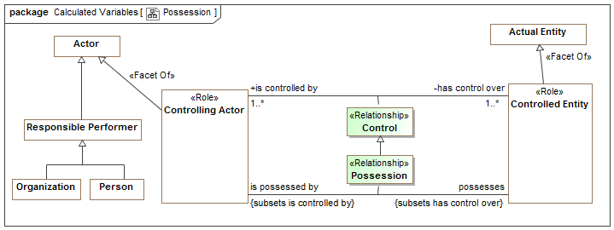
Example of Modeling Style
Control Possession relationships are “first class” – have a timeframe, can be part of cause and effect, etc.
“Controlling Actor” is a role – people and organizations can play this role
Both entity classes and relationships form hierarchies
There are multiple ways “data structures” could be arranged to represent this information or a subset of it – that is the subject of mappings.

Slide 36
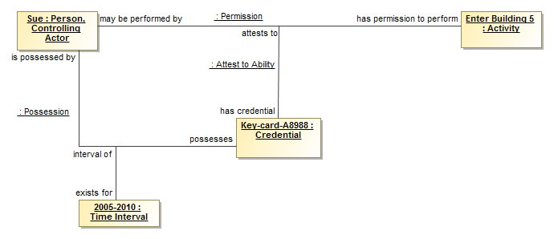
Example Instances
In the time interval from 2005-2010 Sue <possesses>“Key-card-A8988” that <attests to> the permission: Sue <has permission to perform> “Enter Building 5”.
Note: Note the best notation; this is intended to validate the model using UML.

Slide 37
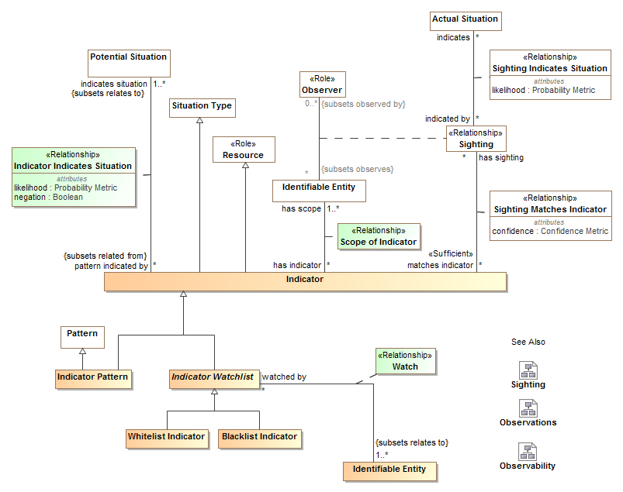
Example of more threat-specific module

Slide 38
Model/Ontology/Vocabulary Representation
Operational Threat/Risk uses the in-progress “Semantic Information Modeling for Federation” (SIMF) specification, being developed in the OMG.
SIMF defines a foundational semantic conceptual model for the modeling language as well as a UML (Unified Modeling Language) profile.
The UML Profile is what has been shown, using the “Cameo Concept Modeler” from Nomagic.
Based on the (draft) specification, CCM is able to generate OWL for the threat/risk model. Other implementation technologies could be generated as well.

Slide 39
Data Mappings
STIX & NIEM

Slide 40
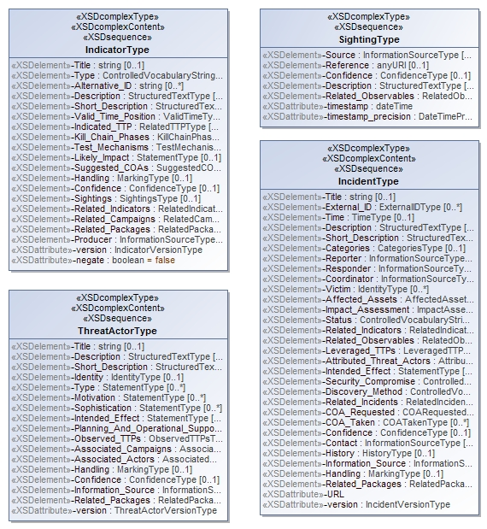
Representing the STIX physical model
<xs:complexContent>
<xs:extension base="stixCommon:IndicatorBaseType">
<xs:sequence>
<xs:element name="Title" type="xs:string" minOccurs="0">
<xs:annotation>
<xs:documentation>The Title field provides a simple title for this Indicator.</xs:documentation>
</xs:annotation>
</xs:element>
<xs:element name="Type" type="stixCommon:ControlledVocabularyStringType" minOccurs="0" maxOccurs="unbounded">
<xs:annotation>
<xs:documentation>Specifies the type or types for this Indicator.</xs:documentation>
<xs:documentation>This field is implemented through the xsi:type controlled vocabulary extension mechanism. The default vocabulary type is IndicatorTypeVocabularyType in the http://stix.mitre.org/default_vocabularies-1 namespace. This type is defined in the stix_default_vocabularies.xsd file or at the URL http://stix.mitre.org/XMLSchema/default_vocabularies/1.1.1/stix_default_vocabularies.xsd.</xs:documentation>
<xs:documentation>Users may also define their own vocabulary using the type extension mechanism, specify a vocabulary name and reference using the attributes, or simply use this as a string field.</xs:documentation>
</xs:annotation>
</xs:element>
<xs:element name="Alternative_ID" type="xs:string" minOccurs="0" maxOccurs="unbounded">
<xs:annotation>
<xs:documentation>Specifies an alternative identifier (or alias) for the cyber threat Indicator.</
XML Schema is reverse engineered into UML. Next version of STIX will have native UML model.

Slide 41
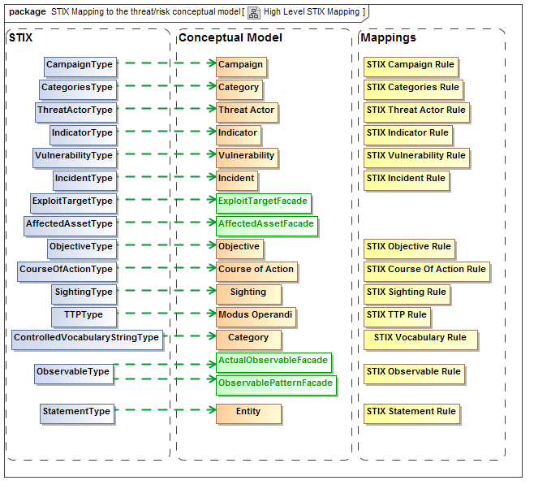
XML Element represents concept
Mapping
Rule
Represents
STIX XSD
Concepts

Slide 42
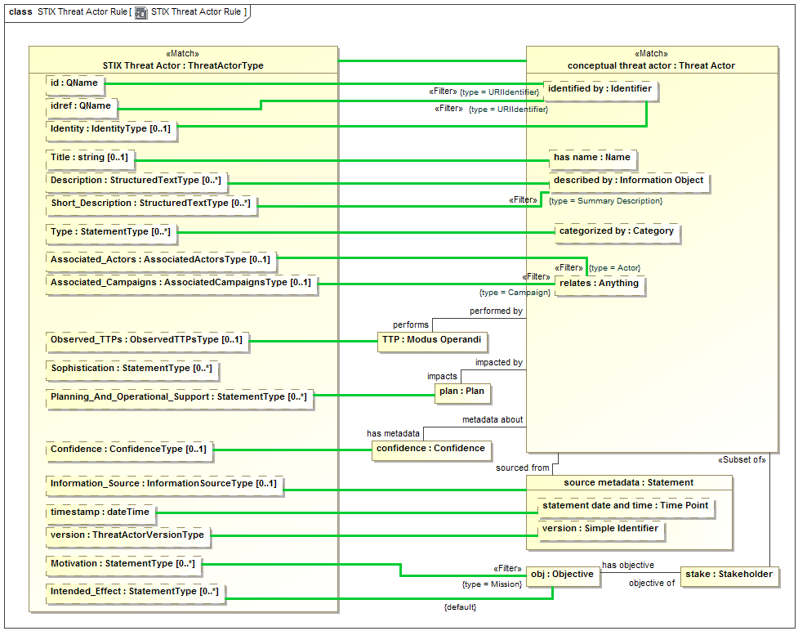

Slide 43
Example STIX source data
<stix:Incident id="example:incident-fd56fb34-af59-47b3-95cf-7baaaa53fe93" timestamp="2014-08-28T16:42:52.859547+00:00" xsi:type='incident:IncidentType' version="1.1.1">
<incident:Title>Breach of Canary Corp</incident:Title>
<incident:Time>
<incident:Incident_Discovery precision="second">2013-01-13T00:00:00</incident:Incident_Discovery>
</incident:Time>
<incident:Description>Intrusion into enterprise network</incident:Description>
<incident:Reporter>
<stixCommon:Description>The person who reported it</stixCommon:Description>
<stixCommon:Identity id="example:Identity-5db269cf-e603-4df9-ae8c-51ff295abfaa">
<stixCommon:Name>Sample Investigations, LLC</stixCommon:Name>
</stixCommon:Identity>
<stixCommon:Time>
<cyboxCommon:Produced_Time>2014-03-11T00:00:00</cyboxCommon:Produced_Time>
</stixCommon:Time>
</incident:Reporter>
<incident:Victim id="example:Identity-c85082f3-bc04-43c8-a000-e0c1d0f2c045">
<stixCommon:Name>Canary Corp</stixCommon:Name>
</incident:Victim>
<incident:Impact_Assessment>
<incident:Effects>
<incident:Effect xsi:type="stixVocabs:IncidentEffectVocab-1.0">Financial Loss</incident:Effect>
</incident:Effects>
</incident:Impact_Assessment>
<incident:Confidence timestamp="2014-08-28T16:42:52.859570+00:00">
<stixCommon:Value xsi:type="stixVocabs:HighMediumLowVocab-1.0">High</stixCommon:Value>
</incident:Confidence>
</stix:Incident>

Slide 44
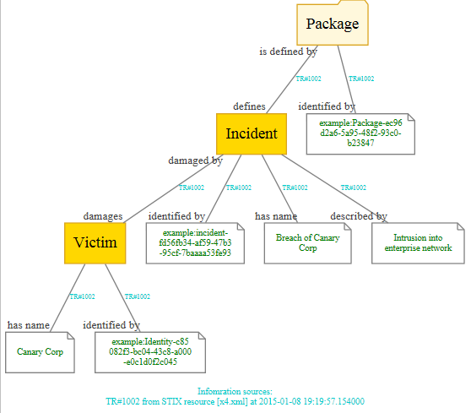
Example of mapped data graph
Provenance

Slide 45
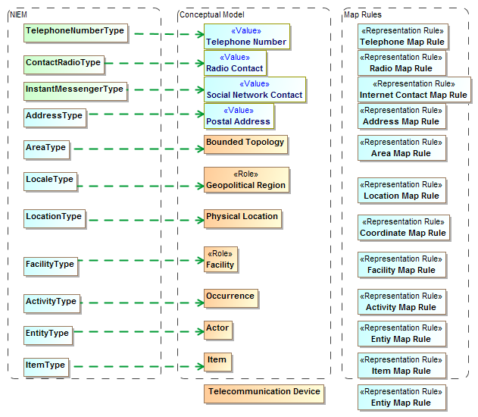
NIEM Mapping summary (1)

Slide 46
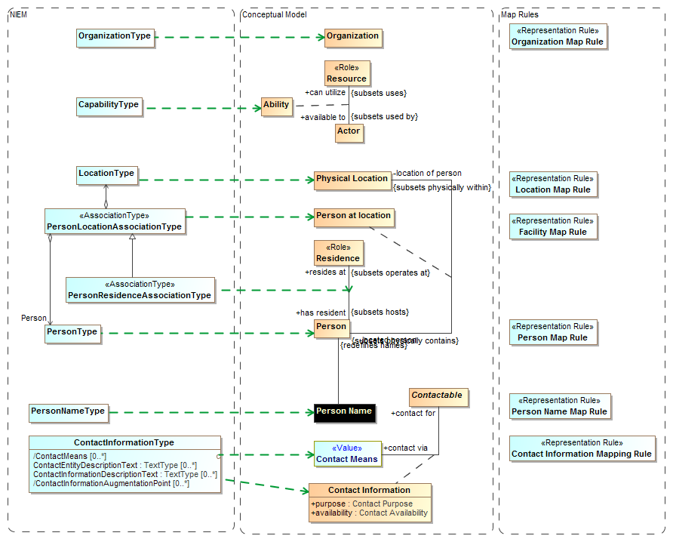

Slide 47
Result of mapping
Two-way semantic “pivot” through conceptual reference models

Slide 48
Next Steps
Further engagement of stakeholders
Validation against user requirements, use cases and data
Reference and pilot implementations

